Slide 1

IT Ticket Analysis
Prakamya Verma

Slide 2
Problem Statement
The objective is to analyze the IT support ticket management system to understand the performance of IT agents, the efficiency of ticket resolution, and the satisfaction levels of employees. The analysis aims to identify high and low performers among IT agents, assess the overall effectiveness of the team, and pinpoint areas for improvement in the ticket resolution process. The ultimate goal is to make informed staffing decisions, including hiring, firing, and training, to enhance overall service quality and team performance.

Slide 3
What is IT Ticket Management
The methodical process of managing all incoming IT-related problems and service requests inside a company is known as IT ticket management. From the beginning to the end, it entails gathering, classifying, ranking, allocating, monitoring, and finally addressing these requests. The main goals of this management system, which is usually made possible by specialized help desk or service desk software, are to expedite IT support operations, guarantee prompt and efficient problem solving, and eventually raise end-user satisfaction by offering well-organized and effective support.

Slide 4
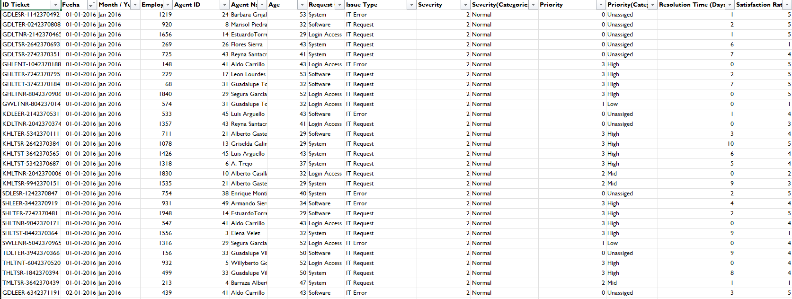
Tickets Sheet Data

Slide 5
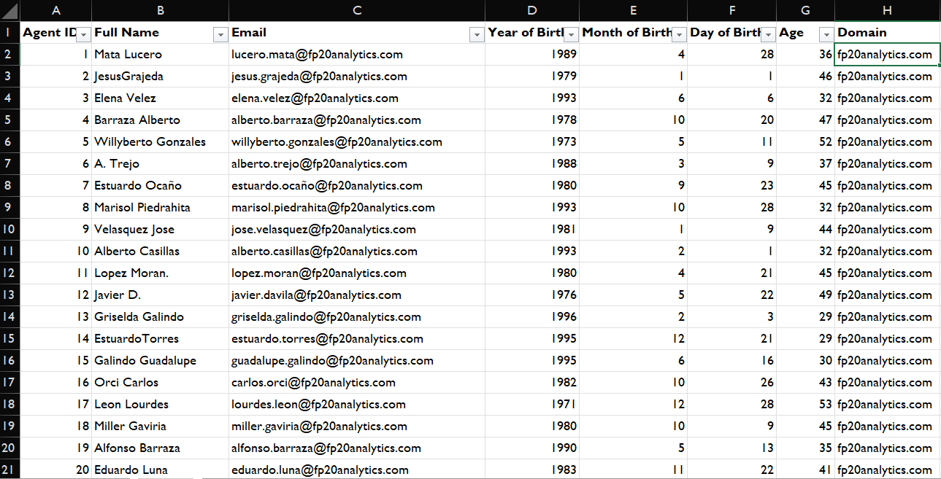
IT Agents Sheet Data

Slide 6
Data Attributes
IT Agents: Contains information about IT agents.
Agent ID: Unique identifier for the agent.
Full Name: Full name of the agent.
Email: Email address of the agent.
Year of Birth: Year the agent was born.
Month of Birth: Month the agent was born.
Day of Birth: Day the agent was born.
Tickets Sheet: Contains information about IT support tickets.
ID Ticket: Unique identifier for the ticket.
Fecha: Date of the ticket.
Employee ID: ID of the employee who raised the ticket.
Agent ID: ID of the agent assigned to the ticket.
Request Category: Category of the request (e.g., Login Access, System, Software).
Issue Type: Type of issue (e.g., IT Error, IT Request).
Severity: Severity of the issue.
Priority: Priority level of the issue.
Resolution Time (Days): Time taken to resolve the ticket.
Satisfaction Rate: Satisfaction rate provided by the employee (1-5 scale).

Slide 7
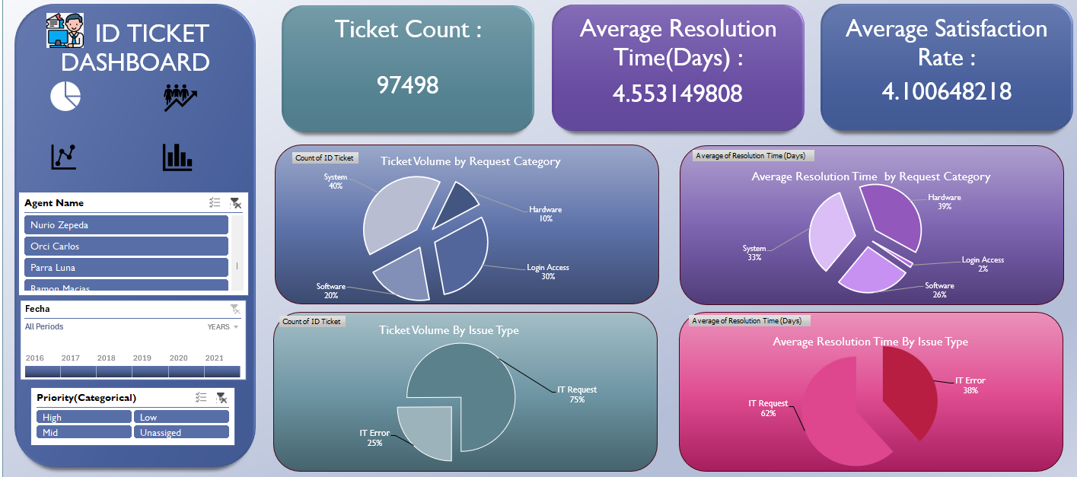
Dashboard Images

Slide 8
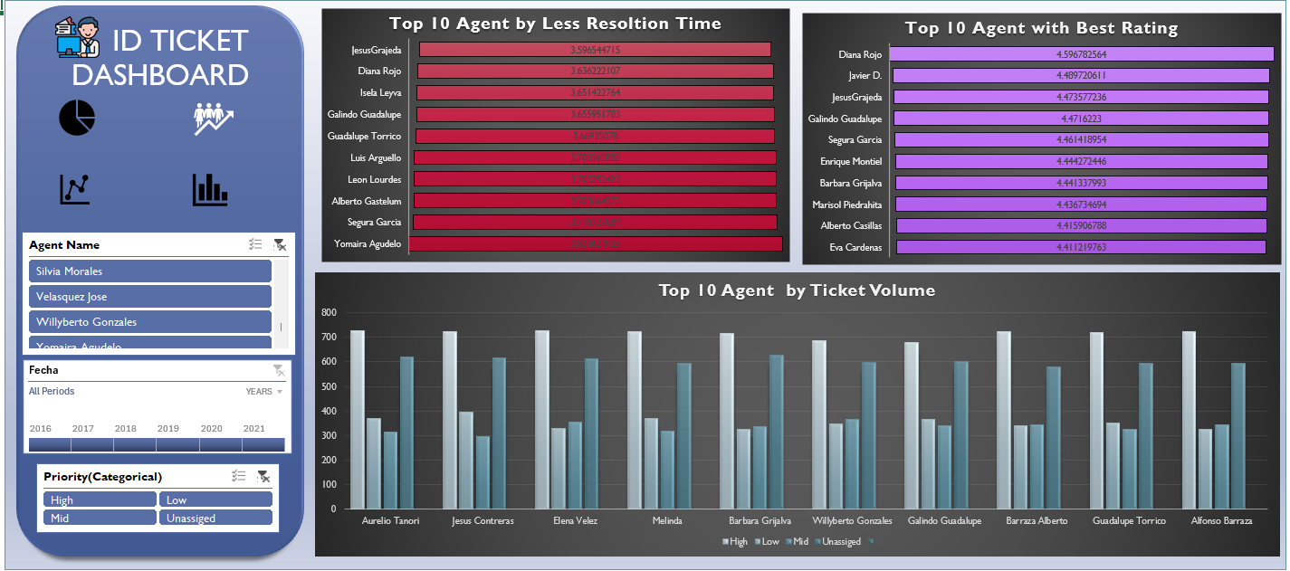
Dashboard Images

Slide 9
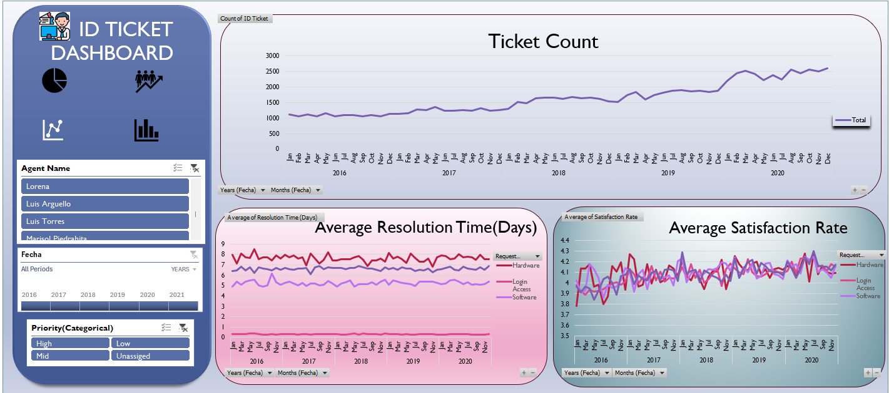
Dashboard Images

Slide 10
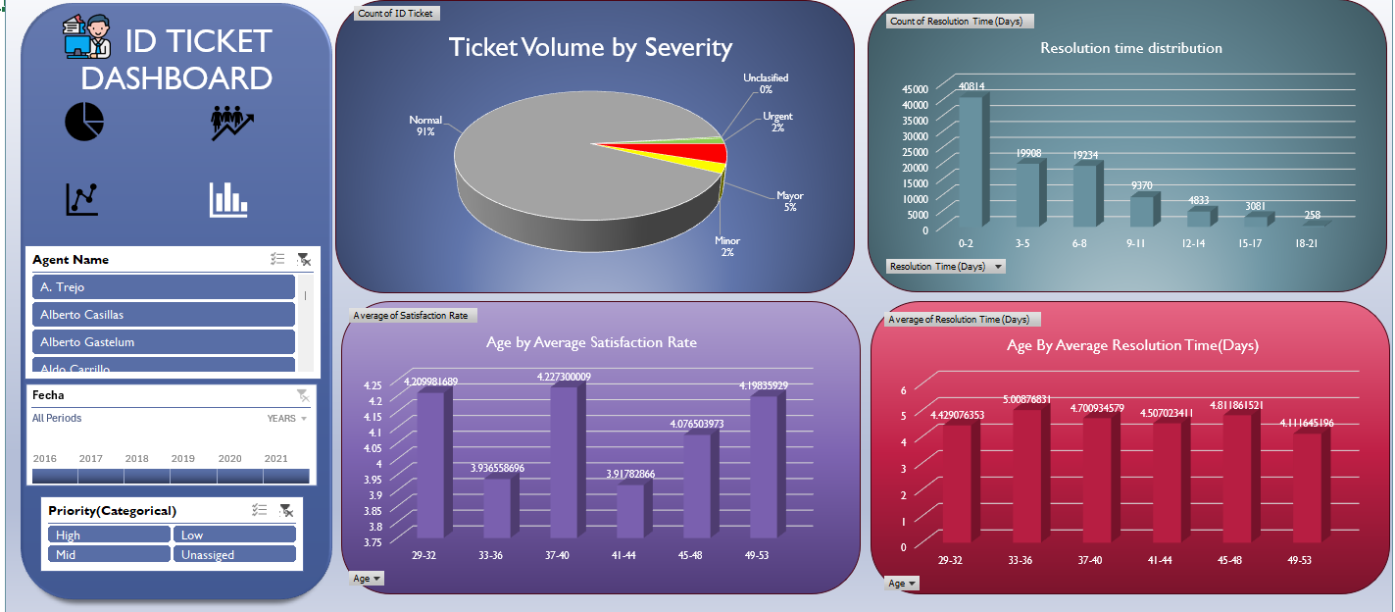
Dashboard Images

Slide 11

Insights
The average daily ticket volume is approximately 53.
Hardware has the lowest ticket volume, but the longest resolution time.
Aurelio Tanori Resolved Highest no of tickets i.e. 2027 overall

Slide 12
Insights
Hardware has the lowest ticket volume, but the longest resolution time.
System and Login Access categories account for the vast majority of IT requests.
System issues account for 40% of tickets, Login Access 30%, Software 20%, and Hardware 10%
Login Access has the lowest resolution time

Slide 13
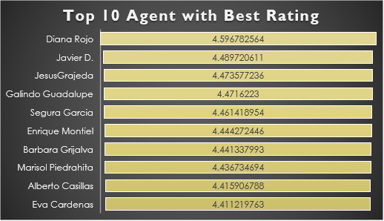
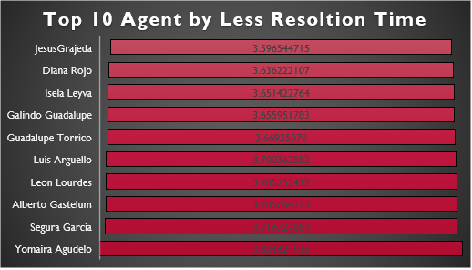
Insights
The correlation between resolution time and satisfaction (-0.0036) indicates almost no relationship, meaning faster resolutions don’t necessarily guarantee happier users.
Jesus Grajeda and Diana Rojo, These two are best agent when it comes to resolution time
Diana Rojo and Javier D., These two are best agent when it comes to Rating
Diana Rojo has best rating and very less resolution time

Slide 14
Insights
Ticket volumes peaked sharply in 2020, but satisfaction rates remained stable or even improved, suggesting that process efficiency and agent performance improved over time. Peak months: Aug–Dec 2020 Stable months: Jan–Apr 2017–2018
Seasonal fluctuations exist with higher activity in Q1, mid-year, and year-end, but the overall trend is escalating demand.

Slide 15
Insights
The majority of tickets (~42% or 40,814) are resolved within 0–2 days, indicating strong efficiency for quick-resolution issues. However, nearly 40% of tickets (3–8 days range) take moderately longer, suggesting room for process or automation improvements.
A smaller fraction (~10% of tickets) extend beyond 9 days, highlighting potential bottlenecks in complex issue categories that could benefit from targeted training or escalation optimization.

Slide 16
Recommendation
Agent Name
Alfonso Barraza
A. Trejo
Sandra Lujan
Nurio Zepeda
Elena Velez
Lorena
Guadalupe Villanueva
Lopez Moran.
Jesus Pacheco
Orci Carlos
Alfredo Barreras
Velasquez Jose
Aldo Carrillo
Luis Arguello
Parra Luna
Reyna Santacruz
Estuardo Ocaño
Flores Sierra
Agents Having Average Satisfaction Rate Less than 4.0
For agents with low satisfaction ratings, provide specialized training on customer service and communication skills.

Slide 17
Recommendation
Agent Name
Jesus Contreras
Estuardo Ocaño
Lorena
Ramon Macias
Mata Lucero
Nurio Zepeda
Elena Velez
Armando Sierra
Griselda Galindo
A. Trejo
Rosa Olguin
Barraza Alberto
Sandra Lujan
Alfonso Barraza
EstuardoTorres
Silvia Morales
Parra Luna
Guadalupe Villanueva
Agents Having Average Resolution time more than 4.8 Days
Agents with long resolution times, implement technical proficiency and process efficiency training, focusing on advanced troubleshooting, diagnostic tools, and knowledge base utilization.
Specifically train the 33-37 age group on System and Software troubleshooting.

Slide 18


